Slide 1


1. Javascript Refresher
Below are the important concepts of Javascript one should know before diving into React js:
Arrays and Array methods(map and filter)
Array of Objects
Arrow Functions
Destructuring
Spread Operator
Ternary Operator

Slide 2
Let’s see all of them one by one with some examples
Arrays and Array Methods:
In javaScript , array is a single variable that is used to store different elements. It is often used when we want to store a list of elements and access them by a single variable. It is a linear collection of elements, where each element can be of any data type, such as numbers, strings, objects, or even mixed. In short we can say that an array is a special variable, which can hold more than one value. Array is zero-indexed, which means the first element is accessed using the index 0, the second element with index 1, and so on. You can access array elements using their index.

Slide 3
Example:
const games = [“Cricket”, “Hockey”, “Football”, “Volleyball”, “Tennis”, “Golf”]
Now if I want to print all the elements of above array one by one then how can I do it?
Well, the answer is very simple. As we have seen every element of array has an index. So let’s breakdown the above example. Cricket will have index 0, Hockey will have index 1, Football will have index 2 and so on.
So in order to print every element we can see the code below along with output.

Slide 4
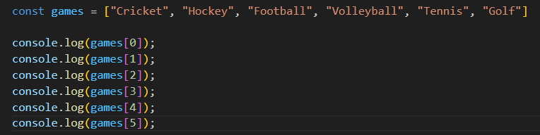
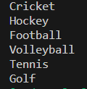

Slide 5
But calling every element individually becomes a very hectic task especially when there are a large number of elements in an array. Suppose you have 100 elements in an array then calling each one of them becomes very tedious or impossible task. So, what we can do? map() method helps in this case.
So what exactly is Array.map() method?
The map() method is an array method in JavaScript that allows you to iterate over each element of an array and perform a specified operation on each element. It returns a new array with the results of applying the provided function to each element. The map() method is called on an array and takes a callback function as its argument. The callback function is executed for each element in the array. Below is it’s example

Slide 6
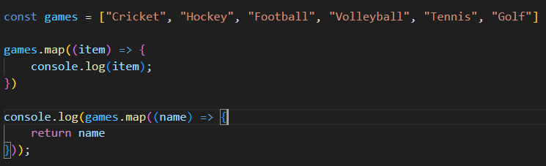
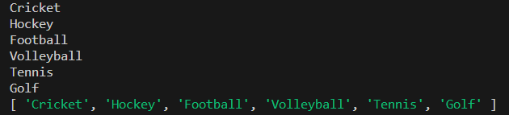

Slide 7
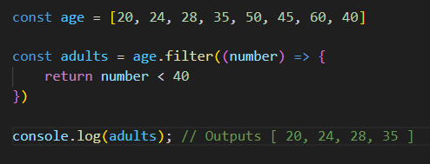
Array.filter() method
The filter() method in JavaScript is used to create a new array that contains elements from the original array that pass a certain condition specified by a provided function. It filters out elements that do not meet the condition and returns a new array with the filtered elements.
const numbers = [1, 2, 3, 4, 5, 6];
const evenNumbers = numbers.filter((number) => {
return number % 2 === 0;
});
console.log(evenNumbers); // Output: [2, 4, 6]

Slide 8
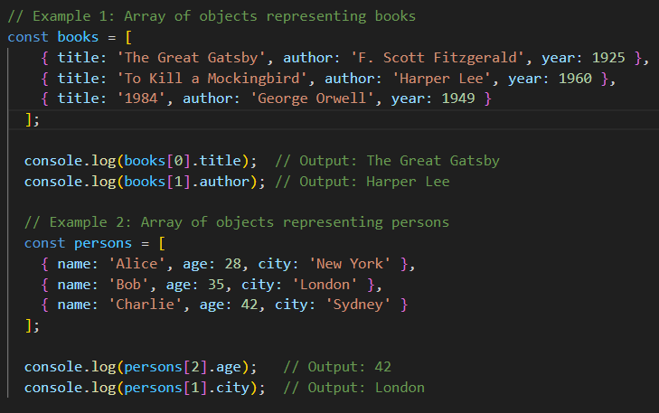
Array of Objects:
Until now we have seen array of string and number. Now let’s see some examples of array of objects. An array of objects is a data structure in JavaScript that allows you to store multiple objects in a single array. Each object within the array can have its own properties and methods. Example:

Slide 9
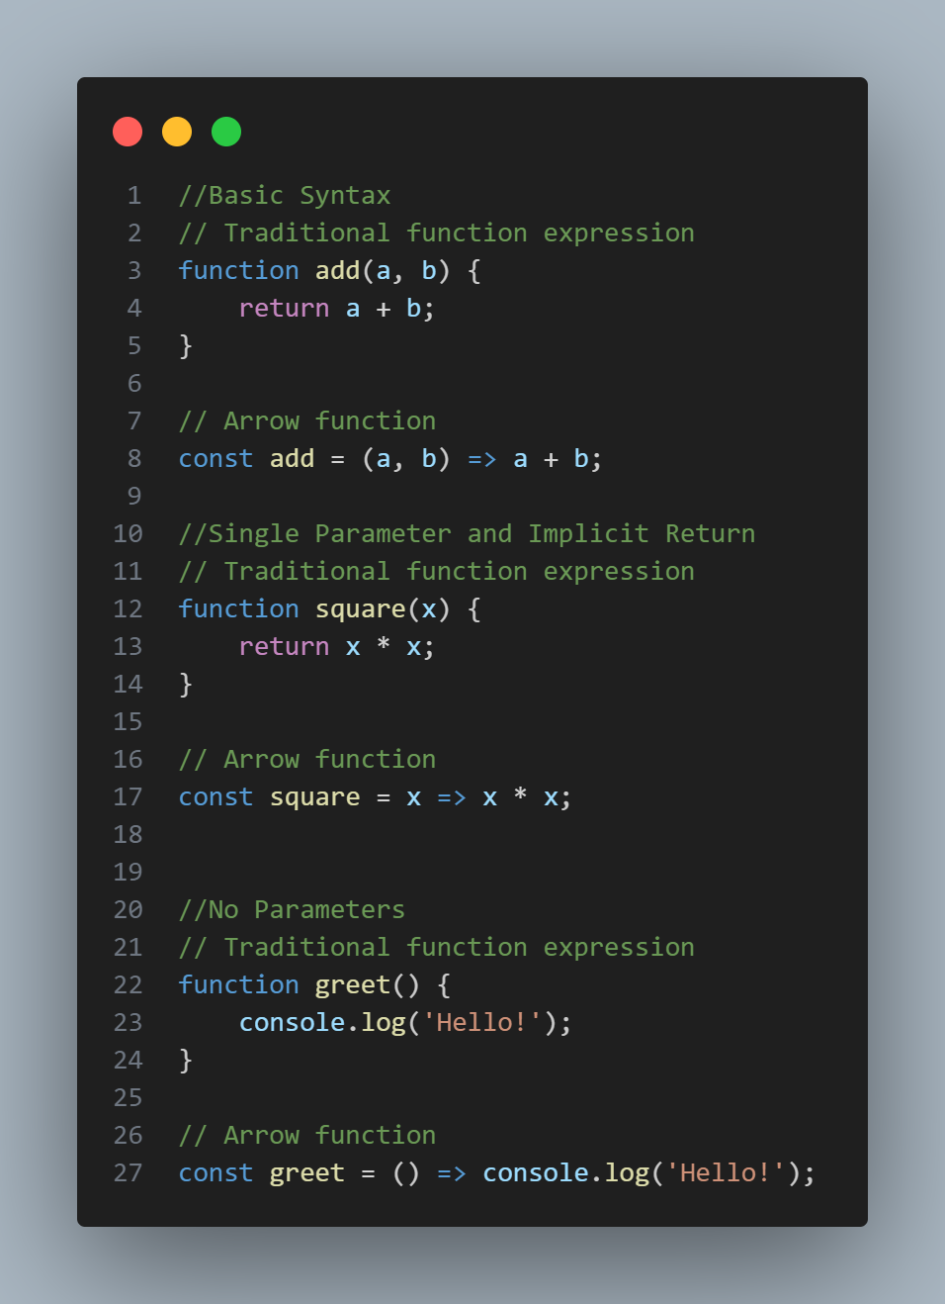
3. Arrow Functions:
Arrow functions, also known as fat arrow functions, are syntax in JavaScript for creating functions. They provide a shorter and more readable way to define functions compared to traditional function expressions. Syntax:

Slide 10
4. Destructuring:
Destructuring is a feature in JavaScript that allows you to extract values from arrays or properties from objects into distinct variables. It provides a concise and convenient way to unpack values, making code more readable and expressive.

Slide 11
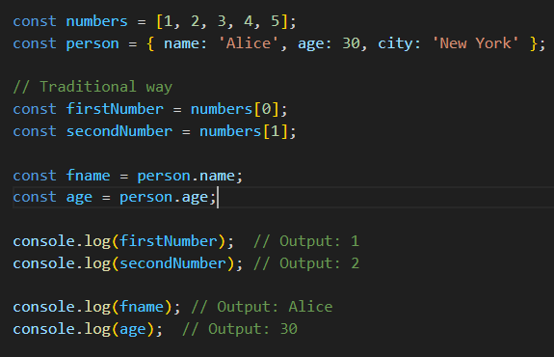
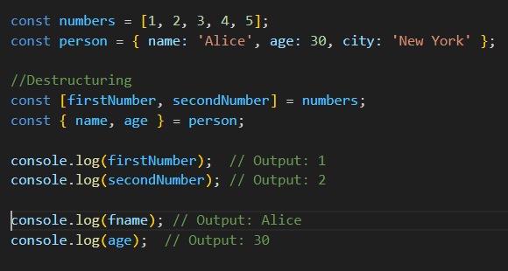

Slide 12
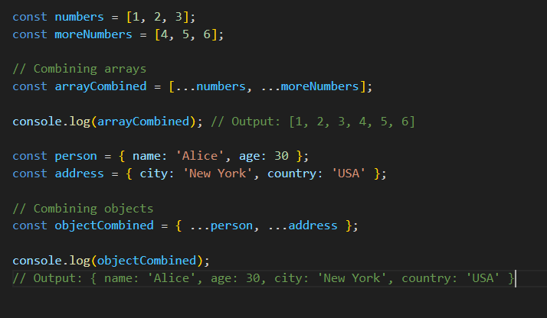
5. Spread Operator:
Spread operator is a powerful feature in JavaScript that allows you to expand elements from an iterable (like an array or string) or properties from an object into another array, object, or function call. It provides a concise syntax for manipulating and combining data.

Slide 13
6. Ternary Operator:
Ternary operator is a shorthand syntax for writing conditional statements in JavaScript. It allows you to write concise if-else conditions in a single line.

Slide 14
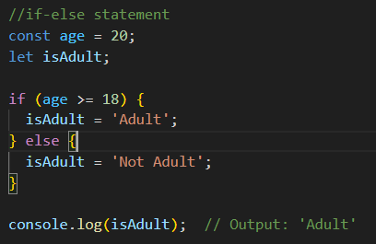
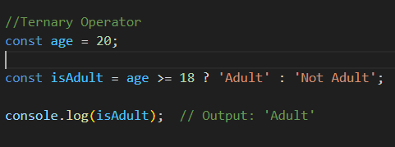

Slide 15
2. Introduction to React
What is React?
React is a JavaScript library used to build user interfaces for web applications. It helps developers create interactive and dynamic UIs by breaking them down into reusable components. React efficiently updates only the necessary parts of the web page, making applications faster and more efficient. It's widely used and popular because it simplifies the process of building complex UIs and promotes code reusability.
Why React is used?
React is used over traditional HTML web development because it offers several advantages. With React, developers can build complex user interfaces more easily by breaking them down into reusable components. For example, instead of writing repetitive HTML code for each element, you can create a reusable component in React and use it multiple times. This saves time and reduces code duplication. React also efficiently updates only the necessary parts of the web page, resulting in faster and more responsive applications.

Slide 16
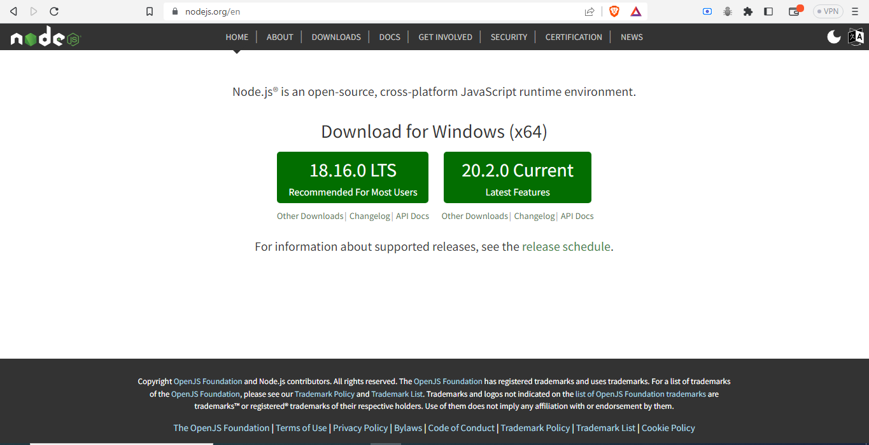
How to set up a React development environment and create a new react application?
1. To begin with, Visit the Node.js website (https://nodejs.org) and download the latest stable version(18.16.0) suitable for your operating system. Follow the installation instructions to complete the setup.

Slide 17
2. Open your terminal or command prompt and navigate to the desired location where you want to create your React project. Use the following command to create a new React project using Create React App.
npx create-react-app my-app
This command will create a new directory with the project structure and install the necessary dependencies.
3. Once the project is created, navigate to the project directory using the following command:
cd my-app
4. To run your React application and see it in the browser, use the following command:
npm start

Slide 18
Understanding the folder structure:
node_modules: This folder contains all the project dependencies, installed via npm or Yarn. You don't need to modify anything here manually.
public: This folder contains the static assets that are directly copied to the build folder without being processed. It usually includes the index.html file, which serves as the entry point for your application.
public/index.html: This file serves as the HTML template for your application. It includes the necessary placeholders where the React components will be rendered.
package.json: This file is the manifest file for your project. It contains metadata about your project, as well as the dependencies and scripts required for building and running the application.
src: This folder contains the source code of your React application. It's where you'll spend most of your time developing and modifying files.

Slide 19
Here are the important files and folders within the src folder:
index.js: This file serves as the entry point for your application. It renders the root component of your app into the DOM.
App.js: This file typically contains the main component of your application. It's where you define the overall structure and logic of your app.
components: This folder is usually created to store reusable and smaller components of your application. You can organize your components hierarchically within this folder.
styles: This folder can be created to store global or shared stylesheets for your application.
In summary, the initial HTML structure is defined in index.html, the rendering of the root component is done in index.js, and the content and behavior of your application are primarily controlled by the components defined in App.js

Slide 20
3. React Components and Props
What are React Components?
React components are reusable building blocks that encapsulate UI elements and their functionality. There are two types of React Components. Class Component and Functional Component but ever since functional components have been introduced we don’t use class components anymore. Functional components are a type of React component that are defined as JavaScript functions. They are simpler and easier to understand compared to class components. Functional components take in a set of props (properties) as input and return JSX (HTML-like) elements that represent the component's UI.
Why they are used?
They are the fundamental building blocks of a React application. Components allow you to break down your user interface into smaller, manageable pieces, making it easier to develop, maintain, and reuse code.

Slide 21
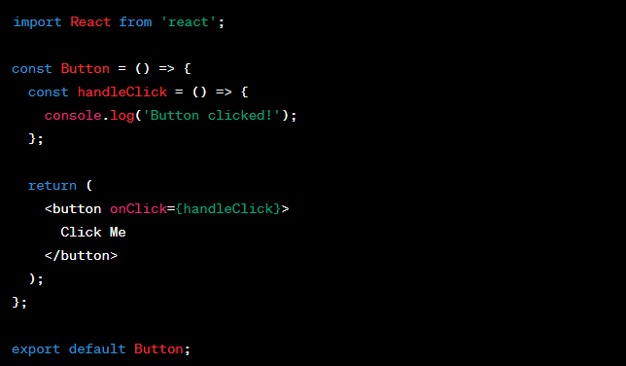
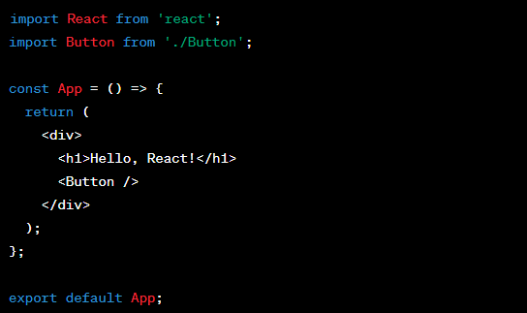
Here’s an example of Functional component in React:
In this example, the Button component is imported and used within the App component. When the button is clicked, it triggers the handleClick function, which logs a message to the console.

Slide 22
What are Props in React and why they are used?
In React, "props" (short for properties) are a way to pass data from a parent component to a child component. They are used to customize and configure child components based on values provided by the parent component. Props are passed as attributes to a component when it is rendered within another component. The child component can access and use these props within its function body to render dynamic content.

Slide 23
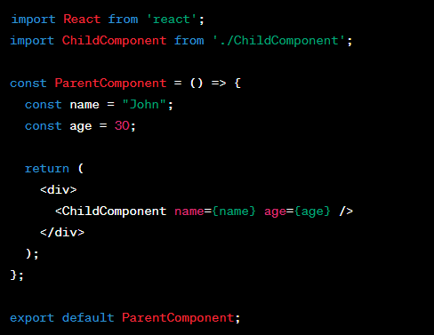
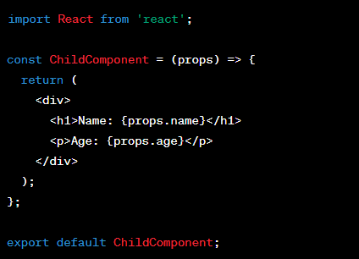
Parent component:
Child component:

Slide 24
In the previous example, the ParentComponent passes two props, name and age , to the ChildComponent. The child component receives these props as an object (props) in its function parameters. Inside the child component, we can access and render the values of these props using the dot notation (props.name and props.age). When the parent component is rendered, the child component will display the name and age passed through the props. This allows for customization and flexibility in rendering components based on dynamic data.
Overall, props play a crucial role in component composition and enable components to be reusable and flexible. They allow for the customization and configuration of child components, making them a powerful mechanism for passing data between components in a React application.

Slide 25
What is Prop Drilling?
Prop drilling is a term used in React to describe the process of passing props through multiple layers of components, even if some intermediate components don't directly use those props.
It occurs when a prop needs to be passed from a top-level component to a deeply nested child component.
Where do we use it?
Prop drilling is typically needed in situations where data or functionality from a top-level component needs to be accessed by a deeply nested component.
It can be challenging and cumbersome because each intermediate component in the hierarchy needs to receive and pass down the prop, even if it doesn't use it.

Slide 26
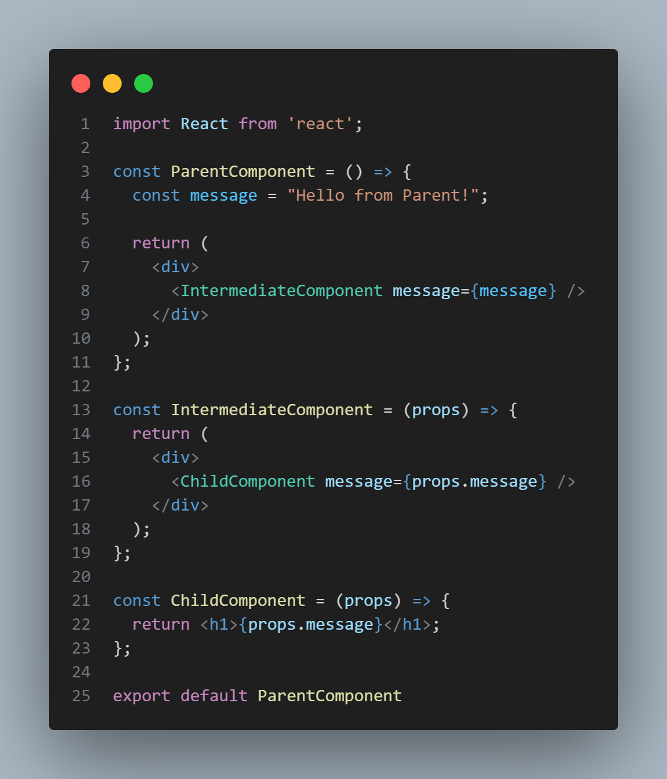
Here's an example to illustrate prop drilling:
In this example, the ParentComponent has a prop called message that needs to be accessed by the ChildComponent. However, the IntermediateComponent is in between and doesn't use the message prop itself. It still needs to receive the message prop and pass it down to the ChildComponent for the final usage

Slide 27
The challenges with prop drilling include:
Passing props through intermediary components: Each intermediate component in the hierarchy needs to receive the prop and pass it down, even if it doesn't use the prop itself. This can make the codebase more complex and harder to maintain.
Increased coupling: Prop drilling can lead to increased coupling between components since they become reliant on the props passed down from higher-level components. This can make refactoring or modifying the component hierarchy more challenging.
Performance impact: Prop drilling can lead to unnecessary re-renders of intermediate components when props are updated. This can impact the performance of the application, especially if the component hierarchy is deep or the props are frequently changing

Slide 28
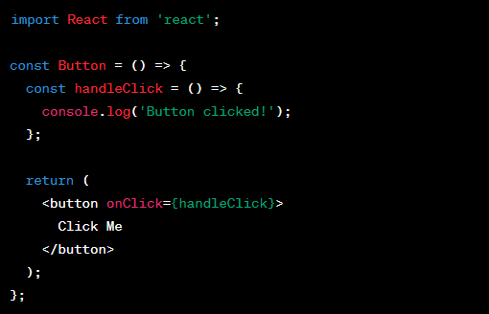
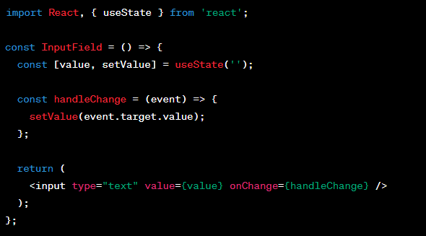
4. React Events and Forms
React Events:
In React, event handling works similarly to traditional JavaScript event handling, but with some differences. Instead of directly attaching event listeners to DOM elements, React uses a synthetic event system for handling events.

Slide 29
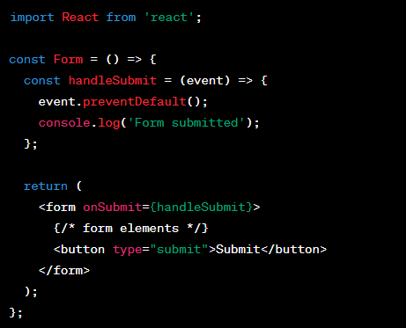
Preventing Automatic Page Refresh on Form Submission:
When we submit the form, the page will refresh. But this is generally not what we want to happen in React. We want to prevent this default behavior and let React control the form. To prevent the default behavior of form submission, you we use the event.preventDefault() method in the submit event handler. By calling this method, you can stop the browser from refreshing the page when the form is submitted. This allows you to handle the form submission using JavaScript without any page reload.

Slide 30
5. React Hooks
The most important React Hooks are:
useState()
useEffect()
useContext()

Slide 31
1. React useState Hook:
The useState Hook in React is a feature that allows functional components to have their own state.
State refers to the data that can change over time and affects how a component behaves and renders.
With the useState Hook, we can declare and manage state variables within functional components without the need for class components.
It provides a way to store and update data, making our components more dynamic and interactive.
By using useState, we can easily keep track of and modify state values within our functional components.

Slide 32
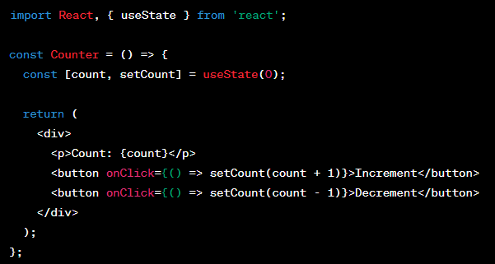
Example:
In this example, the useState Hook is used to declare a state variable called count with an initial value of 0. The setCount function is used to update the value of count in response to user actions. Clicking the "Increment" button increases the count by 1, and clicking the "Decrement" button decreases the count by 1.

Slide 33
Difference between normal variable and useState():
By using useState instead of normal variables, you ensure that the component's state changes are properly managed by React, triggering re-renders and keeping the UI in sync with the underlying data. This is one of the main benefits of using useState and other hooks in React.

Slide 34
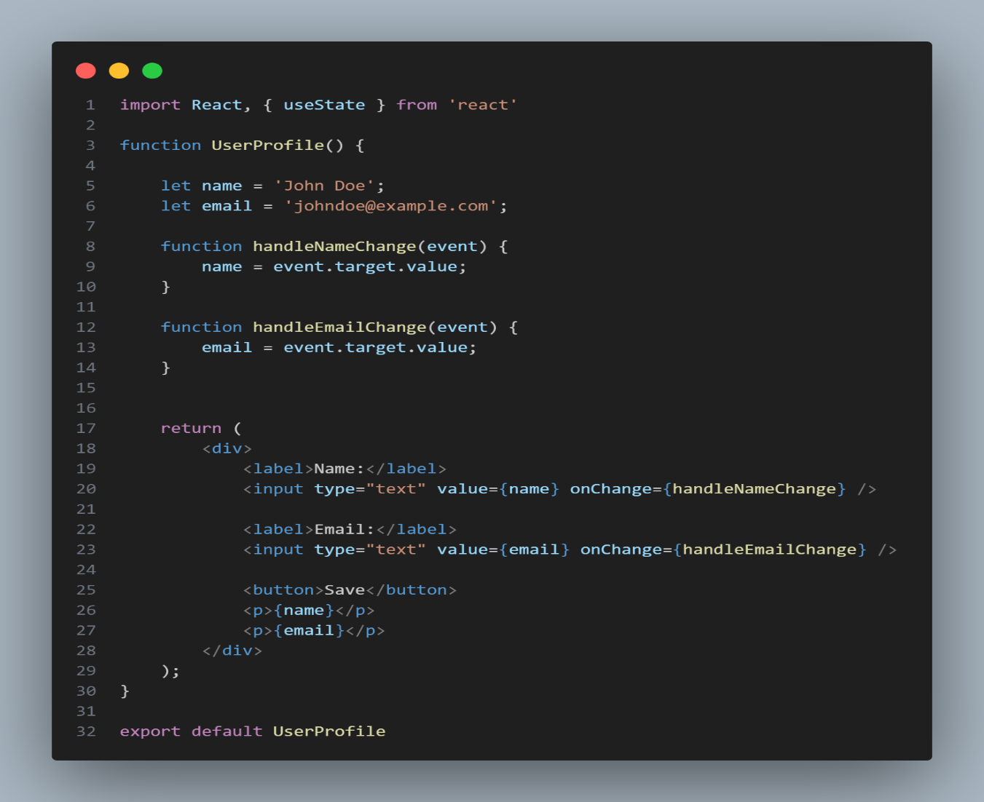
In this example, the name and email variables are declared as normal variables. However, updating their values directly won't trigger a re-render of the component. As a result, when the user types into the input fields, the variable values change, but the UI doesn't reflect those changes. The user's input is essentially ignored.

Slide 35
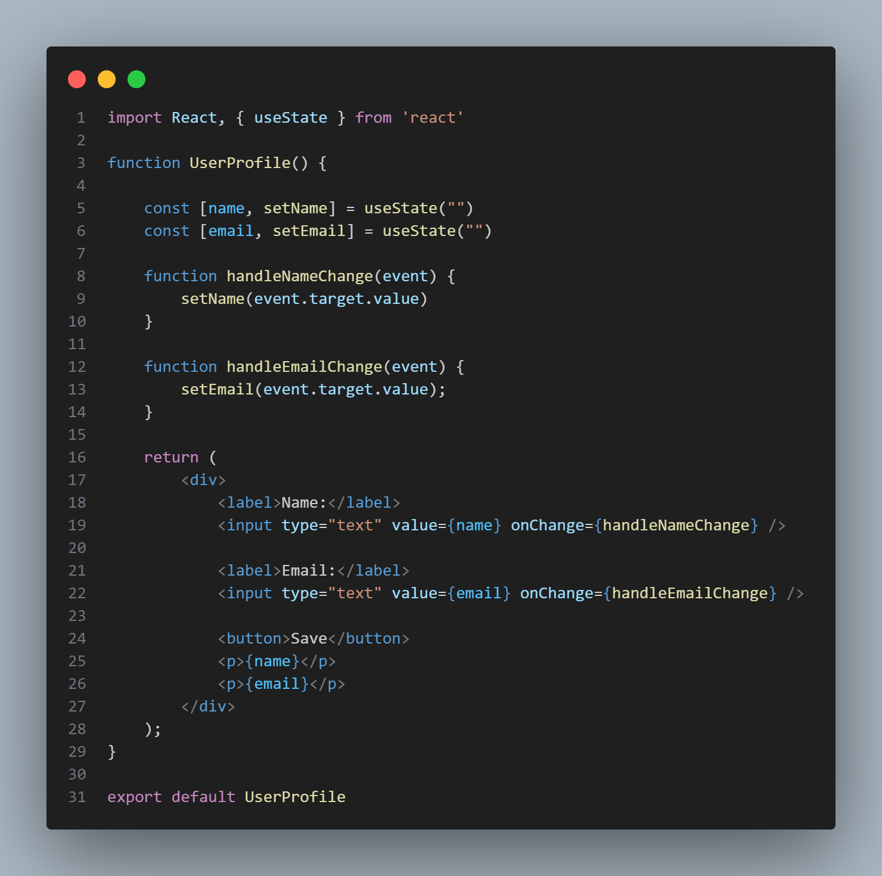
However, in this refactored code, when the user types into the input fields, the handleNameChange and handleEmailChange functions call setName and setEmail , respectively, to update the state variables. As a result, React detects the state changes and triggers a re-render of the component. The UI reflects the updated values in real-time, providing a responsive and interactive user experience.

Slide 36
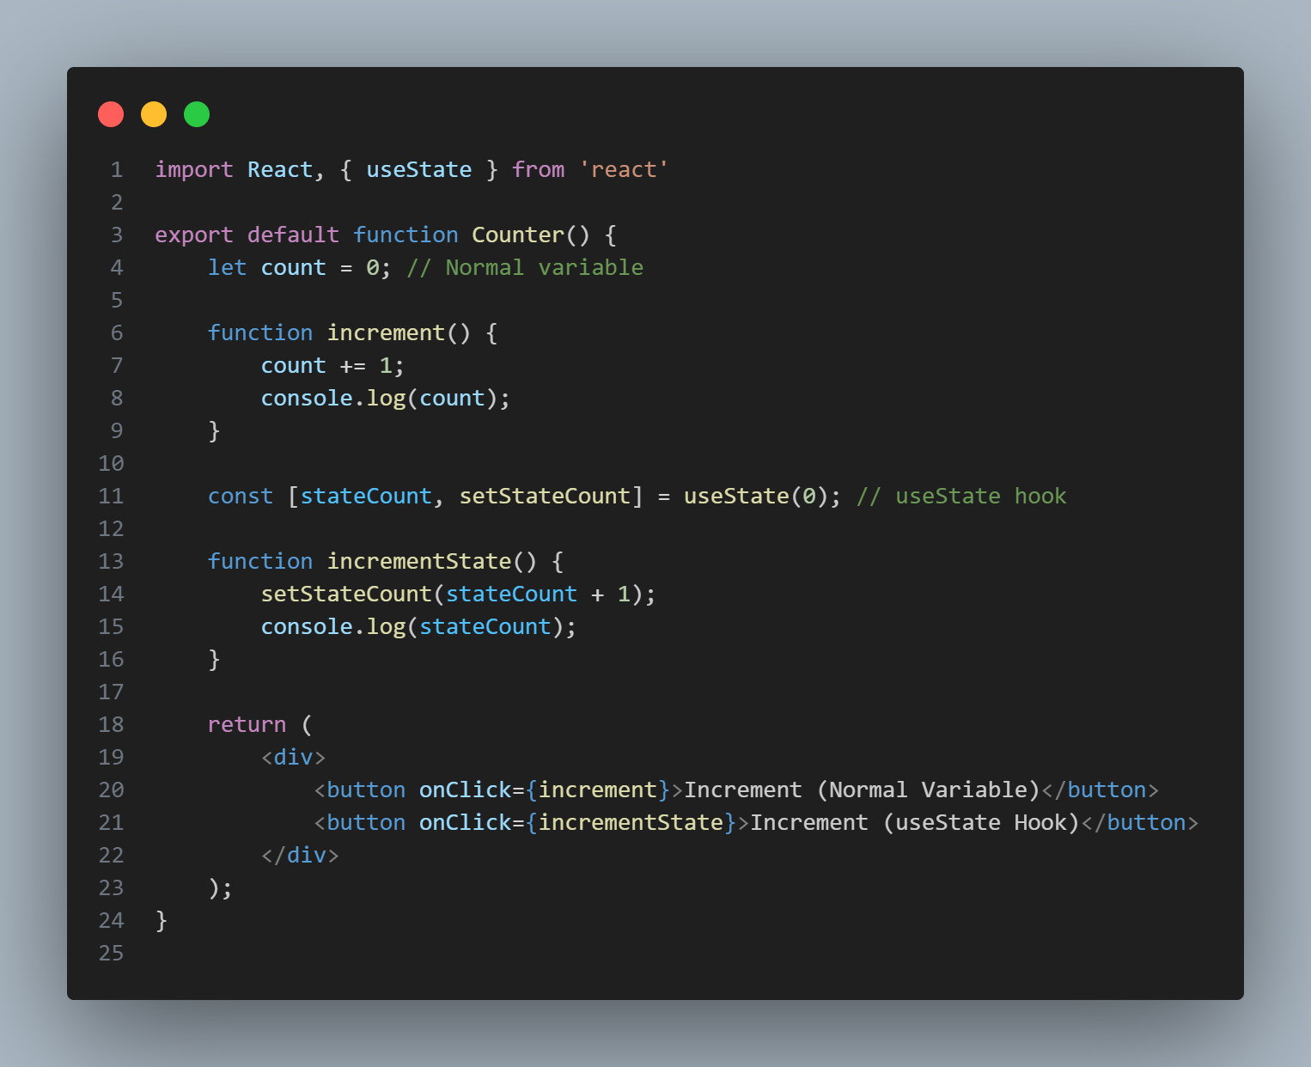

Slide 37
In the previous example, when we click the "Increment (Normal Variable)" button, it increments the count variable directly and logs the updated value to the console. However, if you open the browser console and click the button multiple times, you'll notice that the logged value remains at 1. This is because the component doesn't re-render when the normal variable changes, and the logged value represents the original value of count when the component was first rendered.
On the other hand, when you click the "Increment (useState Hook)" button, it uses the useState hook to manage the stateCount variable. It updates the state using setStateCount and logs the updated value to the console. If you click the button multiple times and observe the console, you'll see that the logged value increases each time, reflecting the updated state value. This is because the useState hook triggers a re-render when the state changes, ensuring that the logged value reflects the most recent state.

Slide 38
2. React useEffect Hook:
The useEffect Hook in React is a built-in function that allows you to perform side effects in your components.
Side effects can include things like fetching data from an API, subscribing to events, or manipulating the DOM.
By using the useEffect Hook, you can specify what should happen after the component renders or when specific dependencies change.

Slide 39
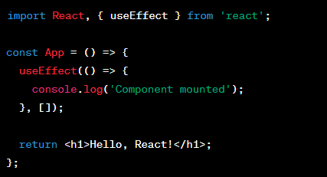
Example 1: Example of running an effect only once
In this example, the useEffect Hook is used to run a function that logs a message when the component mounts. The second parameter of the useEffect function is an empty array [ ] which means the effect is only executed once after the initial render.

Slide 40
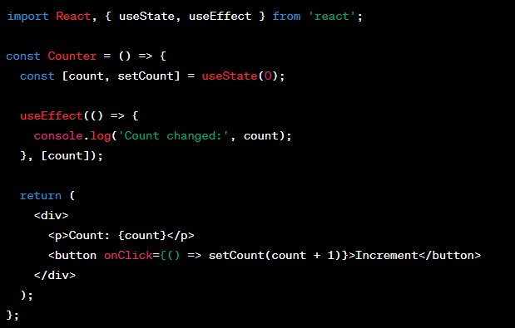
Example 2: Example of running an effect when a dependency changes
In this example, the useEffect Hook is used to log a message when the count state variable changes. The effect runs each time the count value is updated. The second parameter of the useEffect function is an array [count] , specifying the dependency that triggers the effect to run

Slide 41
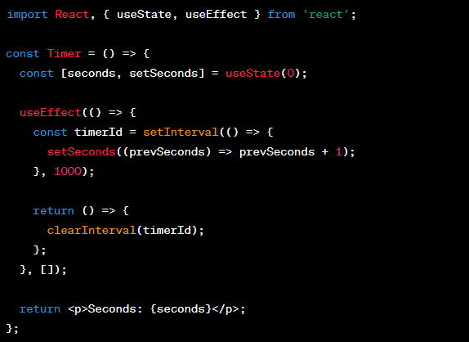
Example 3: Example of cleaning up an effect
In this example, the useEffect Hook is used to start a timer that increments the seconds state variable every second. The effect also returns a cleanup function that clears the interval when the component unmounts.

Slide 42
3. React useContext Hook:
The React useContext Hook is a built-in feature that allows components to access data from a parent component without passing it through props.
It simplifies the process of sharing data across multiple components by creating a shared context that can be accessed by any nested component.
By using useContext, components can directly access the values stored in the context, eliminating the need for prop drilling and making the code more concise and readable.
It eliminates the need for prop drilling by providing a convenient way to access shared data across components.

Slide 43
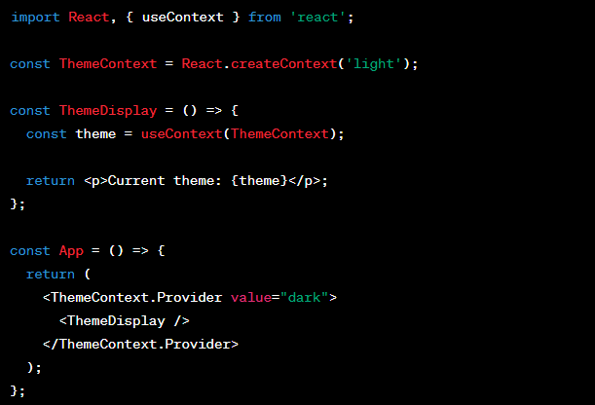
Example:
In this example, a context named ThemeContext is created with a default value of light. The ThemeDisplay component uses the useContext Hook to access the current value of the ThemeContext. The value from the nearest ThemeContext.Provider which is set to dark is displayed

Slide 44
6. React Router
What is React Router and why it is needed?
React Router is a library that helps manage routing in React applications.
Routing refers to the process of navigating between different pages or components within a single-page application.
With React Router v6, you can easily define routes and create navigation links that update the content of your application based on the current URL. It provides a simple and declarative way to handle dynamic routing, allowing users to access different views or components based on the URL path.
To install react-router-dom you need to run the following command:
npm install react-router-dom@version

Slide 45
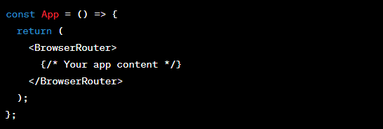
Step by step example of Routing:
1. Import the necessary components from react-router-dom
2. Set up the router component

Slide 46
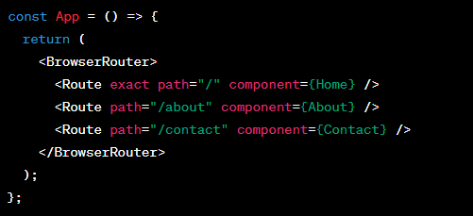
3. Define your routes using the Route component

Slide 47
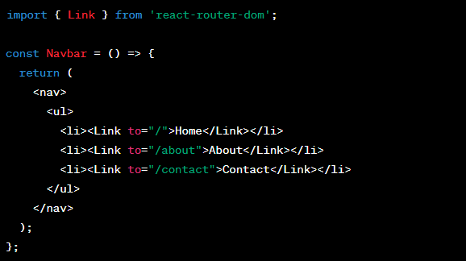
4. Implement navigation using the Link component

Slide 48
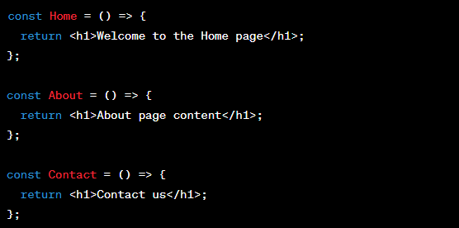
5. Render the routes in your components

Slide 49
Thank You!

